Slide 1
Prickly Port Pirates: Blockchain
Ashton Curry, Brian, and Connor

Slide 2
Introduction to Blockchain

Slide 3
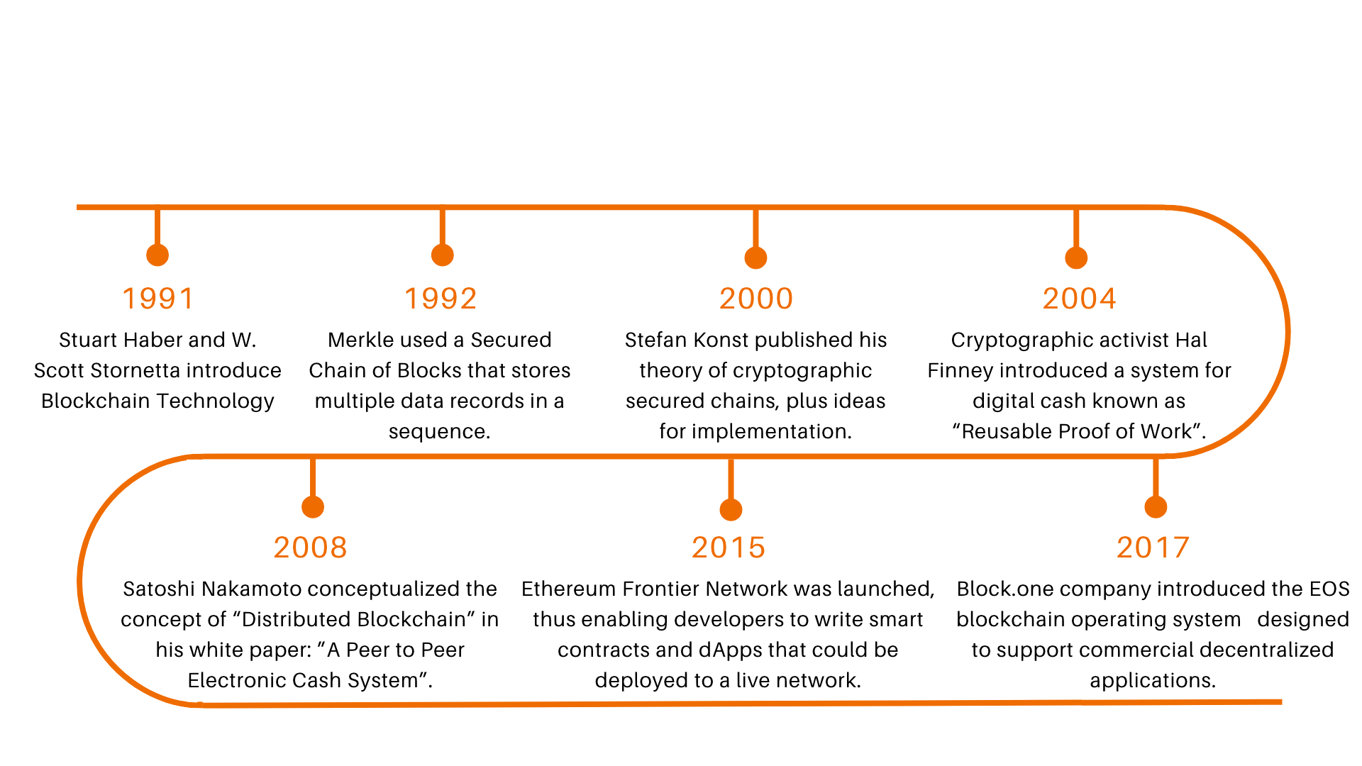
History of Blockchain

Slide 4
Blockchain & Functionality

Slide 5
Blockchain, Enterprise & Networks

Slide 6
Blockchain Implementation
Many demonstrations of Blockchain technology
Internet of Vehicles (Jiang et al., 2019)
Supply Chain transparency (Glgor et al., 2022)
Decentralized storage (Shawn et al., 2016)
Each solve the same problems: Decentralized, Secure, transparent transactions
Our Problem: Transaction between two enterprises on a Wide Area Network (WAN)

Slide 7
Solution Architecture
Six Step solution:
Define the Network
Set Up BlockChain Infrastructure
Implement Smart Contracts
Develop APIs for integration
Frontend Interface
Demonstration of Interoperability.

